Slide 1


Image Captioning by vision encoder decoder models
CSCE 5214 Fall 2021
Project – 2
Aditya Pujari Hemanth Reddy Yerramreddy Praveen Kumar Somara Brinda Potluri Chandrakanth Mandalapu
11491374 11505484 11525451 11526591 11509665

Slide 2

Abstract
This project focuses on captioning an image that has been provided as an input.
A web application using AI would be able to provide in-context captioning to the inputted image
The project would be deployed on Heroku, and Streamlit for the web-Framework.

Slide 3
Agenda
Data Set
Design and Milestones
Vision-To-Text Encoder-Decoder framework(Vit), Encoder , Decoder
Training and Testing
Modules-to-be-Completed
References

Slide 4
Dataset
The data for this project is taken from Flickr Image dataset
The dataset consists of 31.8K images in total.
The dataset also contains the text files of captions to train the model and a separate test-data to test the model
The training data consists of 24000 images, Test data consists of 8000. The remaining amount of data would be used validation purposes.

Slide 5
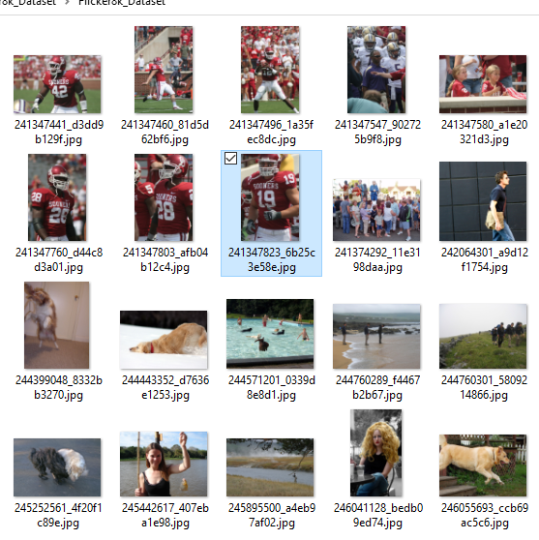
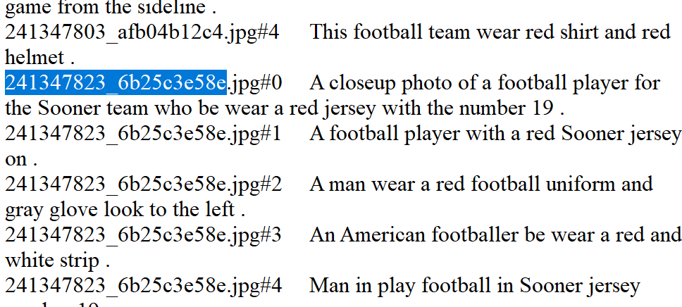
Sample Dataset

Slide 6
Design and Milestones
The project will be done in Python Programming language.
Data pre-processing would be done to resize images to 2048 for efficient runtime and smoother web-experience
The model we are training in is a shared google colab where all team members can share their modules.
The model would be trained using pre-trained ViT models from hugging face for efficient training time without losing out on accuracy.
Programming Language: Python
Model Training: Jupyter Notebook (Google Colab pro -> P100 GPUs)
Dataset: Kaggle
Server (Cloud Platform): Heroku
Web App Framework: Streamlit

Slide 7
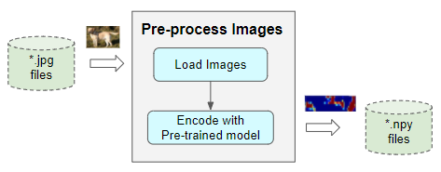
Image Pre-Processing
The primary segment consists of a collection of CNN layers that constantly remove the relevant highlights from the image in order to provide a reduced element map representation.
The Classifier, which is made up of a series of Linear layers, is the next part. It takes an image with a map and forecasts a class (such as canine, automobile, or house) in which the element belongs.

Slide 8
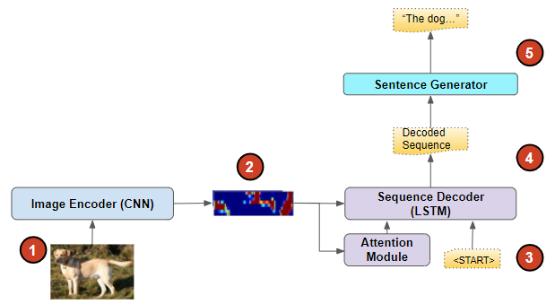
Vision-To-Text Encoder-Decoder framework
ViT models exceed the present state-of-the-art (CNN) in terms of computing efficiency and accuracy by almost 4 times

Slide 9
Encoder and Decoder
The Encoder here is fairly basic, as it is done by the pre-prepared Inception model. It consists of a Linear layer that provides the Decoder with the pre-encoded visual highlights.
The project would use a Sequence Decoder (GRU) along with attention model
After passing via an Embedding layer, the captions are passed in as the input in the Sequence Decoder .
The Attention Module registers the weighted Attention Score based on the encoded image from the Encoder and the hidden state from the Sequence Decoder.

Slide 10
Training and Testing
We are using pre-trained models to train our model.
For the first stage, we use move to figure out how to pre-process the raw images with a CNN-based network that has already been trained. This takes the image as input and outputs encoded image vectors that capture the image's main features. We don't need to do anything else to prepare this network.
Using the pre-prepared model, we extract picture features from the test images.
Greedy Search is used to predict the output by selecting the term with the highest probability at each timestep.

Slide 11
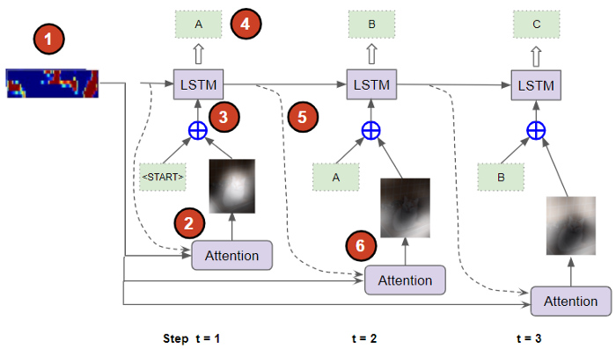

Slide 12
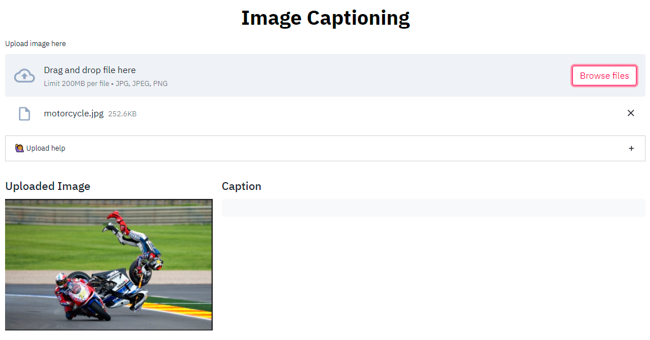
Deployment
We are using Heroku as the deployment server to test the model trained on real time images.
We already created the project and designed the interface.
We still need to map the prediction phase to the deployment server.

Slide 13
Modules-to-be-Completed
Complete the full training of the model in the pre-trained models.
Integrating the model with the frontend webserver.
Evaluating test cases and the model's performances on various pre-trained models. to check its reliability

Slide 14
References
https://towardsdatascience.com/image-captions-with-attention-in-tensorflow-step-by-step-927dad3569fa
https://towardsdatascience.com/image-captions-with-deep-learning-state-of-the-art-architectures-3290573712db
http://www.jair.org/papers/paper3994.html

Slide 15

Thank You

